Slide 1

ABE 715
Computer Programming
Lecture 9: Numerical Methods I - Root Finding
Solving for Unknowns in Engineering Equations
Dr. Kadeghe G. Fue
Department of Agricultural Engineering
1

Slide 2
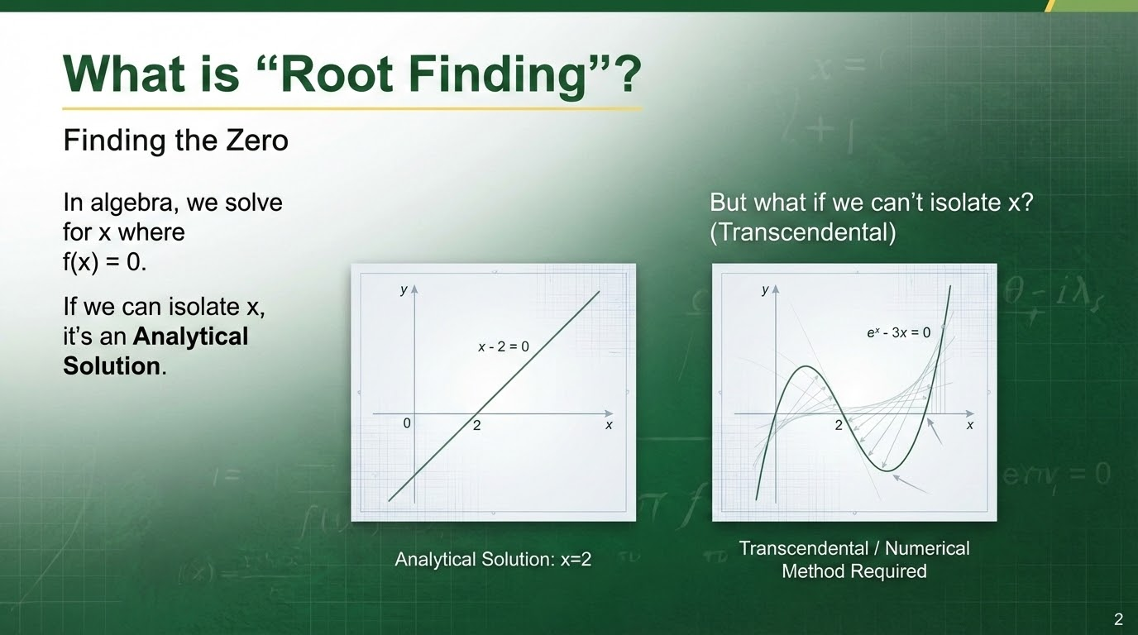

Slide 3
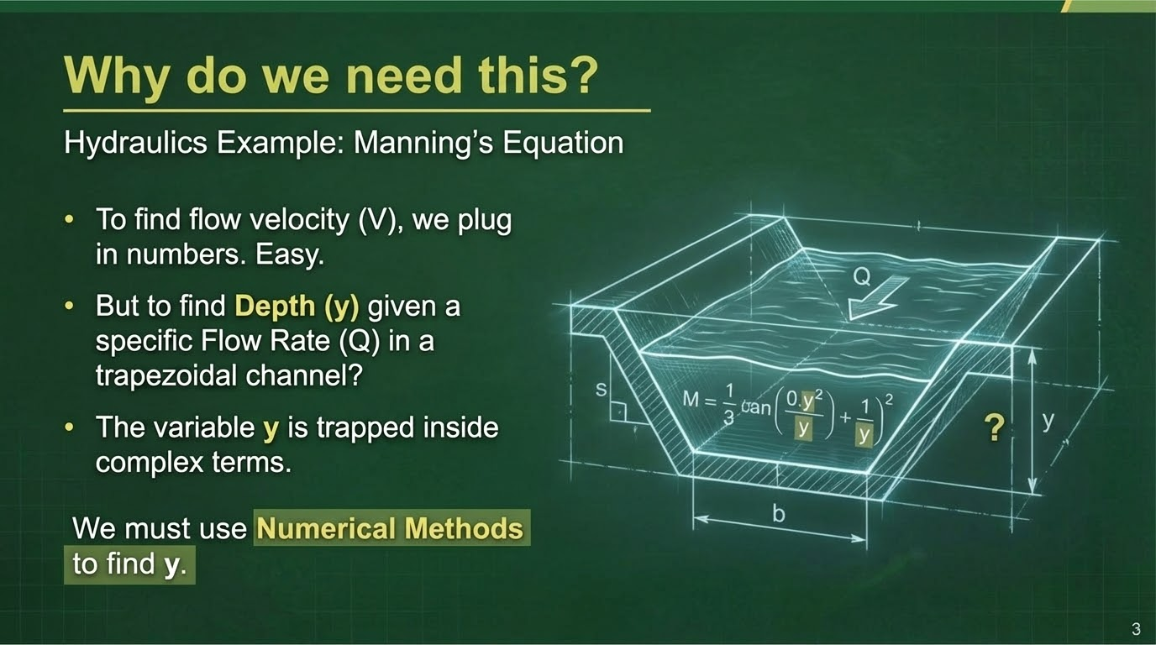

Slide 4
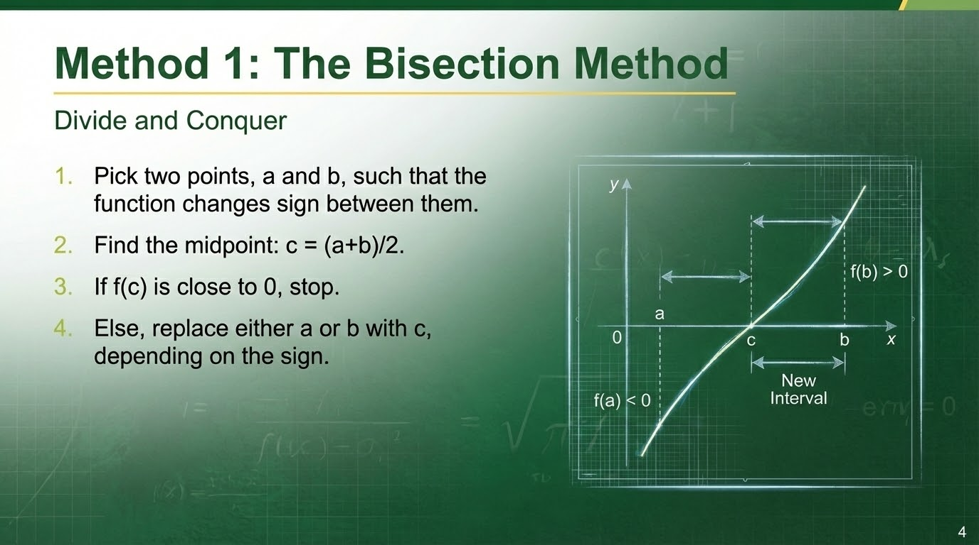

Slide 5
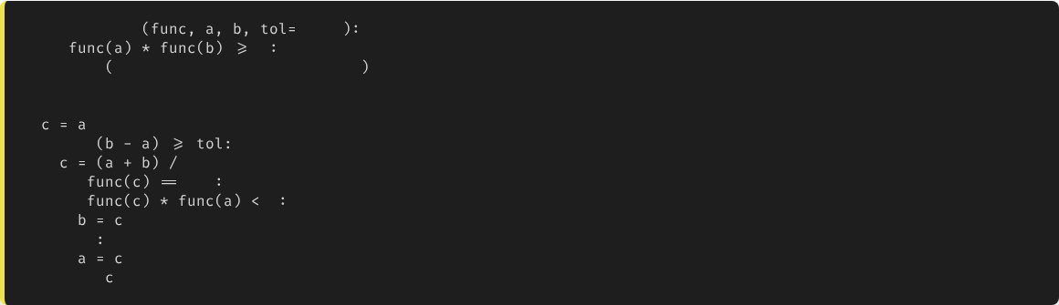
Bisection: Python Implementation
def
bisection
0.001
if
0
print
"No root in this interval!"
return None
while
2
if
0.0
break
if
0
else
return
5

Slide 6





Bisection Analysis
Reliable
Slow
Simple
If you bracket the root correctly, this method is guaranteed to converge.
It cuts the error in half each time, but takes many iterations for high precision.
Requires no calculus (derivatives), just the function values.
6

Slide 7
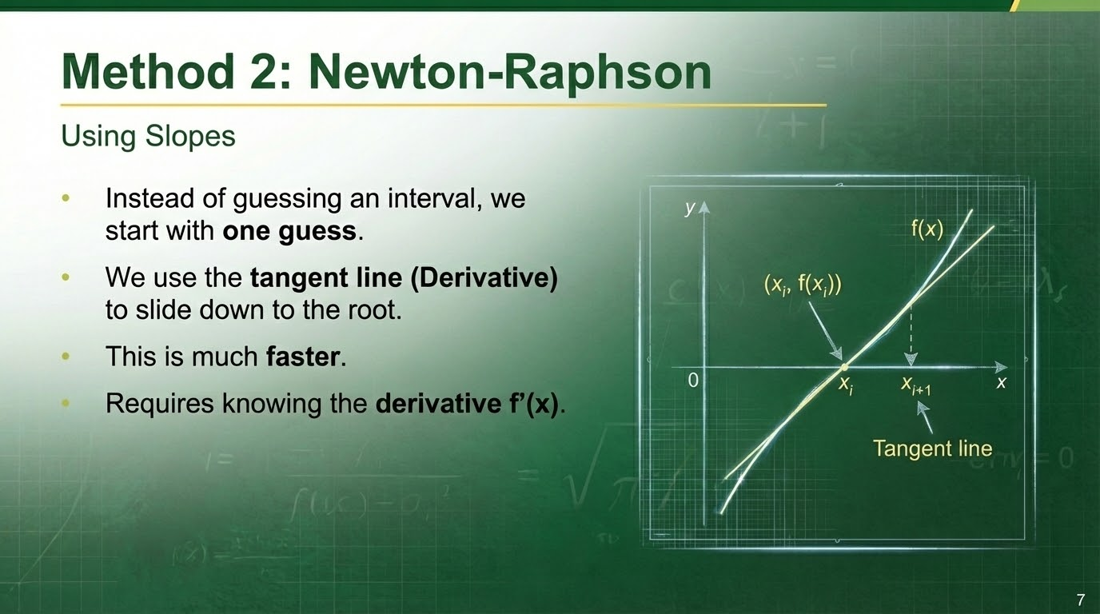

Slide 8
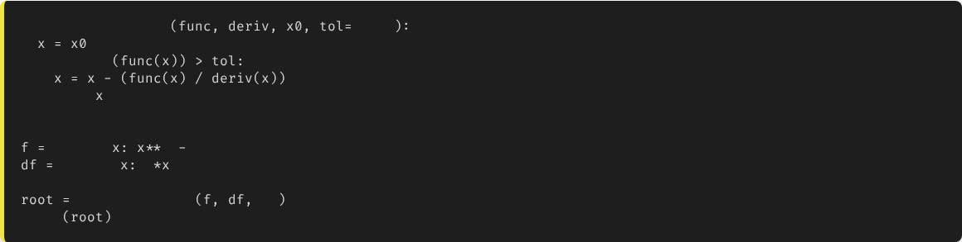
Newton-Raphson Implementation
def
newton_raphson
0.001
while
abs
return
# Example: Solve x^2 - 4 = 0
lambda
2
4
lambda
2
newton_raphson
10
print
# Converges to 2.0 very fast
8

Slide 9
Comparison: Speed vs. Stability
Feature | Bisection | Newton-Raphson
Speed | Slow (Linear) | Fast (Quadratic)
Stability | Very Stable | Can Diverge (if slope is 0)
Requirements | Two guesses (bracketing) | One guess + Derivative
9

Slide 10
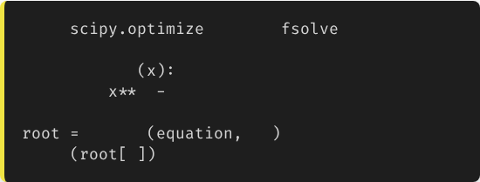
Professional Tools: SciPy
Don't write it from scratch!
from
import
For research and production code, we use the scipy.optimize library.
def
equation
return
2
4
It contains highly optimized versions of these algorithms (e.g., fsolve, brentq).
fsolve
10
print
0
10

Slide 11
Best Practices
•
Graph It First: Always plot the function using Matplotlib to see where the root roughly is. This helps you pick good initial guesses.
•
Check Constraints: In engineering, variables must make sense. (e.g., Water depth cannot be negative).
•
Handle Divergence: If Newton-Raphson fails, fallback to Bisection.
11

Slide 12

Lecture 9: Take-Home Assignment
The Hydraulic Depth Challenge
Scenario: You are designing a rectangular channel. The flow equation is:
Where Q = 10 m³/s, n = 0.015, S = 0.001, width b = 4m.
Task:
1.
Define the function f(y) in Python. (Note: A = b*y, P = b + 2*y)
2.
Use scipy.optimize.fsolve to find the water depth y.
3.
Verify your answer by plugging it back into Manning's Equation.
12

Slide 13
Questions?
Next Class: Numerical Integration (Trapezoidal Rule)
Dr. Kadeghe G. Fue
Department of Agricultural Engineering
13

